Slide 1


FAKE NEWS DETECTION SYSTEM USING MACHINE LEARNING
GROUP MEMBERS :-
SYED SAIFUDDIN CSE-A 160317733018
ATIF ALI KHAN CSE-A 160317733025
MOHD MISBAH UDDIN CSE-A 160317733036
Guide:-
Mr. Yasar Ahmed

Slide 2
Introduction:
Fake news is where individuals or organisations intentionally publish hoaxes, propaganda and other misinformation and present it as factual.
This can include blog and social media posts and fake online media releases.
It also does not include articles that are written from the perspective of a particular opinion or editorial standpoint, provided the information included is factually correct.
Fake news and lack of trust in the media are growing problems with huge ramifications in our society.
In 2010, 0.5 Million were Mobile data users

Slide 3
These days’ fake news is creating different issues from sarcastic articles to fabricated news and plan government propaganda in some outlets.
Obviously, a purposely misleading story is “fake news “ but lately blathering social media’s discourse is changing its definition. Some of them now use the term to dismiss the facts counter to their preferred viewpoints.
The term 'fake news' became common parlance for the issue, particularly to describe factually incorrect and misleading articles published mostly for the purpose of making money through page views. In this project ,it is seeked to produce a model that can accurately predict the likelihood that a given article is fake news.
However, in order to solve this problem, it is necessary to have an understanding on what Fake News is.
Later, it is needed to look into how the techniques in the fields of machine learning, natural language processing help us to detect fake news.

Slide 4
Applications:
Classification of the fake news
Classification of fake articles
Speech recognition
Stance Detection
Fraud detection
Natural language processing
Supervised learning
Unsupervised learning
Intelligent agents

Slide 5
Advantages:
The easy access and exponential growth of the information available on social media networks has made it inticate to distinguish between false and true information
This project will enable users to verify whether given news is real or fake
The credibility of social media networks is also at stake where the spreading of fake information is prevalent
Users can check if the news that is rapidly spreading on social media is infact real or fake
Users can safeguard themselves from false information
Machine learning has played a vital role in classification of the information although with some limitations.
The project can analyse given data and give a prediction in a few seconds

Slide 6
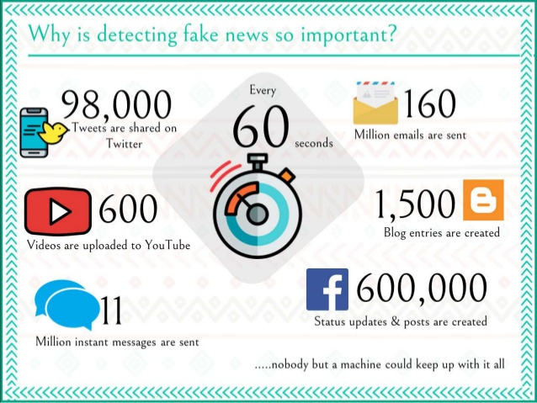
Issues/Challenges:

Slide 7
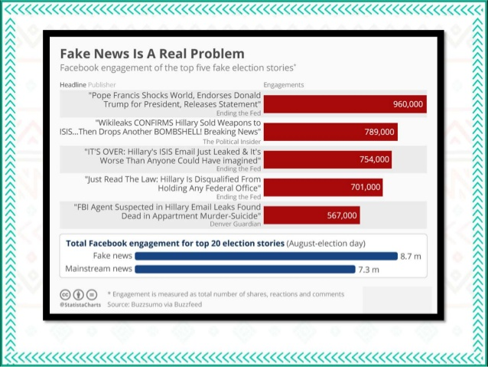

Slide 8


Slide 9
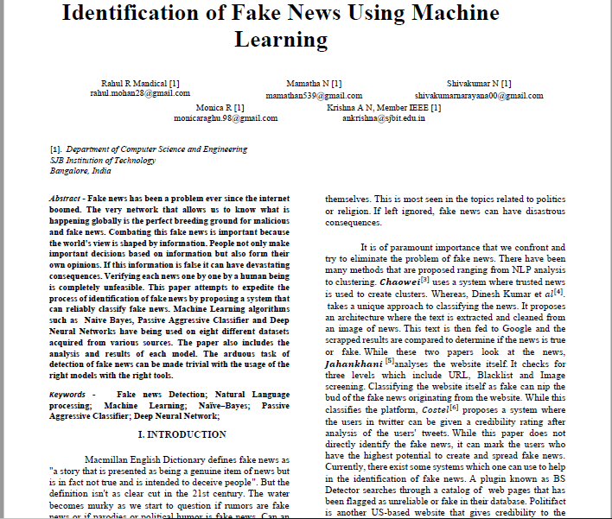
SURVEY/EXISTING SYSTEM:

Slide 10
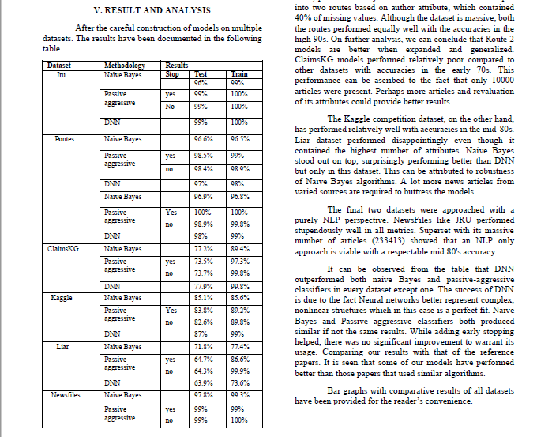

Slide 11
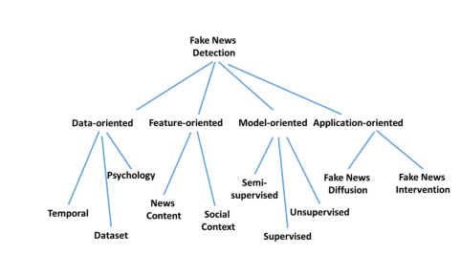
Different approaches to fake news detection

Slide 12
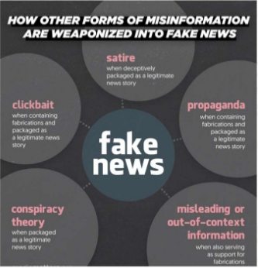

Slide 13


Problem Statement:
Social media and the internet for news consumption is a double-edged sword.
On the one hand, it is low cost, easy to access, and its rapid dissemination of information leads people to seek out and consume news from social media.
On the other hand, it enables the wide spread of “fake news”, i.e., low quality news with intentionally false information.
The extensive spread of fake news has the potential for extremely negative impacts on individuals and society. Therefore, fake news detection on social media and the internet has recently become an emerging research that is attracting tremendous attention.
Fake news detection on social media presents unique characteristics and challenges that make existing detection algorithms from traditional news media ineffective or not applicable

Slide 14


HARDWARE REQUIREMENTS
Physical server or virtual machine.
CPU: 2 x 64-bit, 2.8 GHz, 8.00 GT/s CPUs or better.
Memory: minimum RAM size of 32 GB, or 16 GB RAM with
1600 MHz DDR3 installed, for a typical installation with 50 regular users
Storage: Recommended minimum of 100 GB, or 300 GB
Internet access to download the files
SOFTWARE REQUIREMENTS
Python (Minimum version 3.7.x)
Anaconda Package
Google Chrome
Xampp (For executing PHP files)
HTML5
Operating systems: Windows* 7 or later, macOS, and Linux

Slide 15
PROPOSED SYSTEM
The proposed system will make use of the following algorithms and modules :-
NLP(Natural Language Processing)
Pickle
Maximum Entropy Classifier
Flask App
Newspaper3K Library
TF-IDF
Multinomial Naïve Baiyes

Slide 16
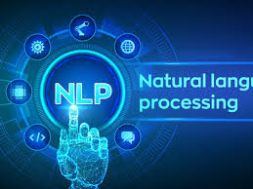
NLP (Natural Language Processing)
Natural Language Processing (NLP) allows machines to break down and interpret human language.
It’s at the core of tools we use every day – from translation software, chatbots, spam filters, and search engines, to grammar correction software, voice assistants, and social media monitoring tools.
Natural Language Processing (NLP) is a field of Artificial Intelligence (AI) that makes human language intelligible to machines.
NLP combines the power of linguistics and computer science to study the rules and structure of language, and create intelligent systems (run on machine learning and NLP algorithms) capable of understanding, analyzing, and extracting meaning from text and speech
Natural language understanding (NLU) is used to understand the structure and meaning of human language by analyzing different aspects like syntax, semantics, pragmatics, and morphology.

Slide 17
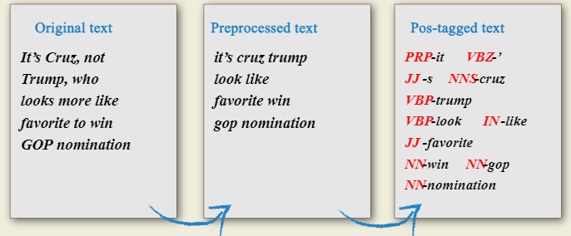
POS (Part Of Speech) Tagging

Slide 18

PICKLE
The pickle module implements binary protocols for serializing and de-serializing a Python object structure.
Pickling” is the process whereby a Python object hierarchy is converted into a byte stream, and “unpickling” is the inverse operation, whereby a byte stream (from a binary file or bytes-like object) is converted back into an object hierarchy.
Warning
The pickle module is not secure. Only unpickle data you trust.
It is possible to construct malicious pickle data which will execute arbitrary code during unpickling. Never unpickle data that could have come from an untrusted source, or that could have been tampered with.

Slide 19
What can be pickled and unpickled?
The following types can be pickled:
None, True, and False
integers, floating point numbers, complex numbers
strings, bytes, bytearrays
tuples, lists, sets, and dictionaries containing only picklable objects
functions defined at the top level of a module (using def, not lambda)
built-in functions defined at the top level of a module
classes that are defined at the top level of a module
instances of such classes whose __dict__ or the result of calling __getstate__() is picklable (see section Pickling Class Instances for details).

Slide 20

FLASK APP
It is a Web Server Gateway Interface (WSGI) web application framework designed to create web apps.
It is passed the name of the module or package of the application. Once it is created it will act as a central registry for the view functions, the URL rules, template configuration and much more.
Usually you create a Flask instance in your main module or in the __init__.py file of your package like this:
from flask import Flask
app=Flask(_name_)

Slide 21
Newspaper3k Library
The Newspaper3k package is a Python library used for Web Scraping articles, It is built on top of requests and for parsing lxml.
This module is a modified and better version of the Newspaper module which is also used for the same purpose.
To install this module type the below command in the terminal.
pip install newspaper3k

Slide 22

Features :-
Multi-threaded article download framework
News url identification
Text extraction from html
Top image extraction from html
All image extraction from html
Keyword extraction from text
Summary extraction from text
Author extraction from text
Google trending terms extraction
Works in 10+ languages (English, Chinese, German, Arabic, …)

Slide 23

TF-IDF
Term Frequency-Inverse Document Frequency is a numerical statistic that is intended to reflect how important a word is to a document in a collection or corpus
The tf–idf value increases proportionally to the number of times a word appears in the document and is offset by the number of documents in the corpus that contain the word, which helps to adjust for the fact that some words appear more frequently in general. tf–idf is one of the most popular term-weighting schemes today
A survey conducted in 2015 showed that 83% of text-based recommender systems in digital libraries use tf–idf

Slide 24
Multinomial Naive Bayes
Naive Bayes is based on Bayes’ theorem, where the adjective Naïve says that features in the dataset are mutually independent
Occurrence of one feature does not affect the probability of occurrence of the other feature.
For small sample sizes, Naïve Bayes can outperform the most powerful alternatives.
Being relatively robust, easy to implement, fast, and accurate, it is used in many different fields.
Multinomial Naive Bayes relies on very simple representation of document as a ‘Bag of words’.
The multinomial Naive Bayes classifier is suitable for classification with discrete features (e.g., word counts for text classification).
The multinomial distribution normally requires integer feature counts. However, in practice, fractional counts such as tf-idf may also work

Slide 25
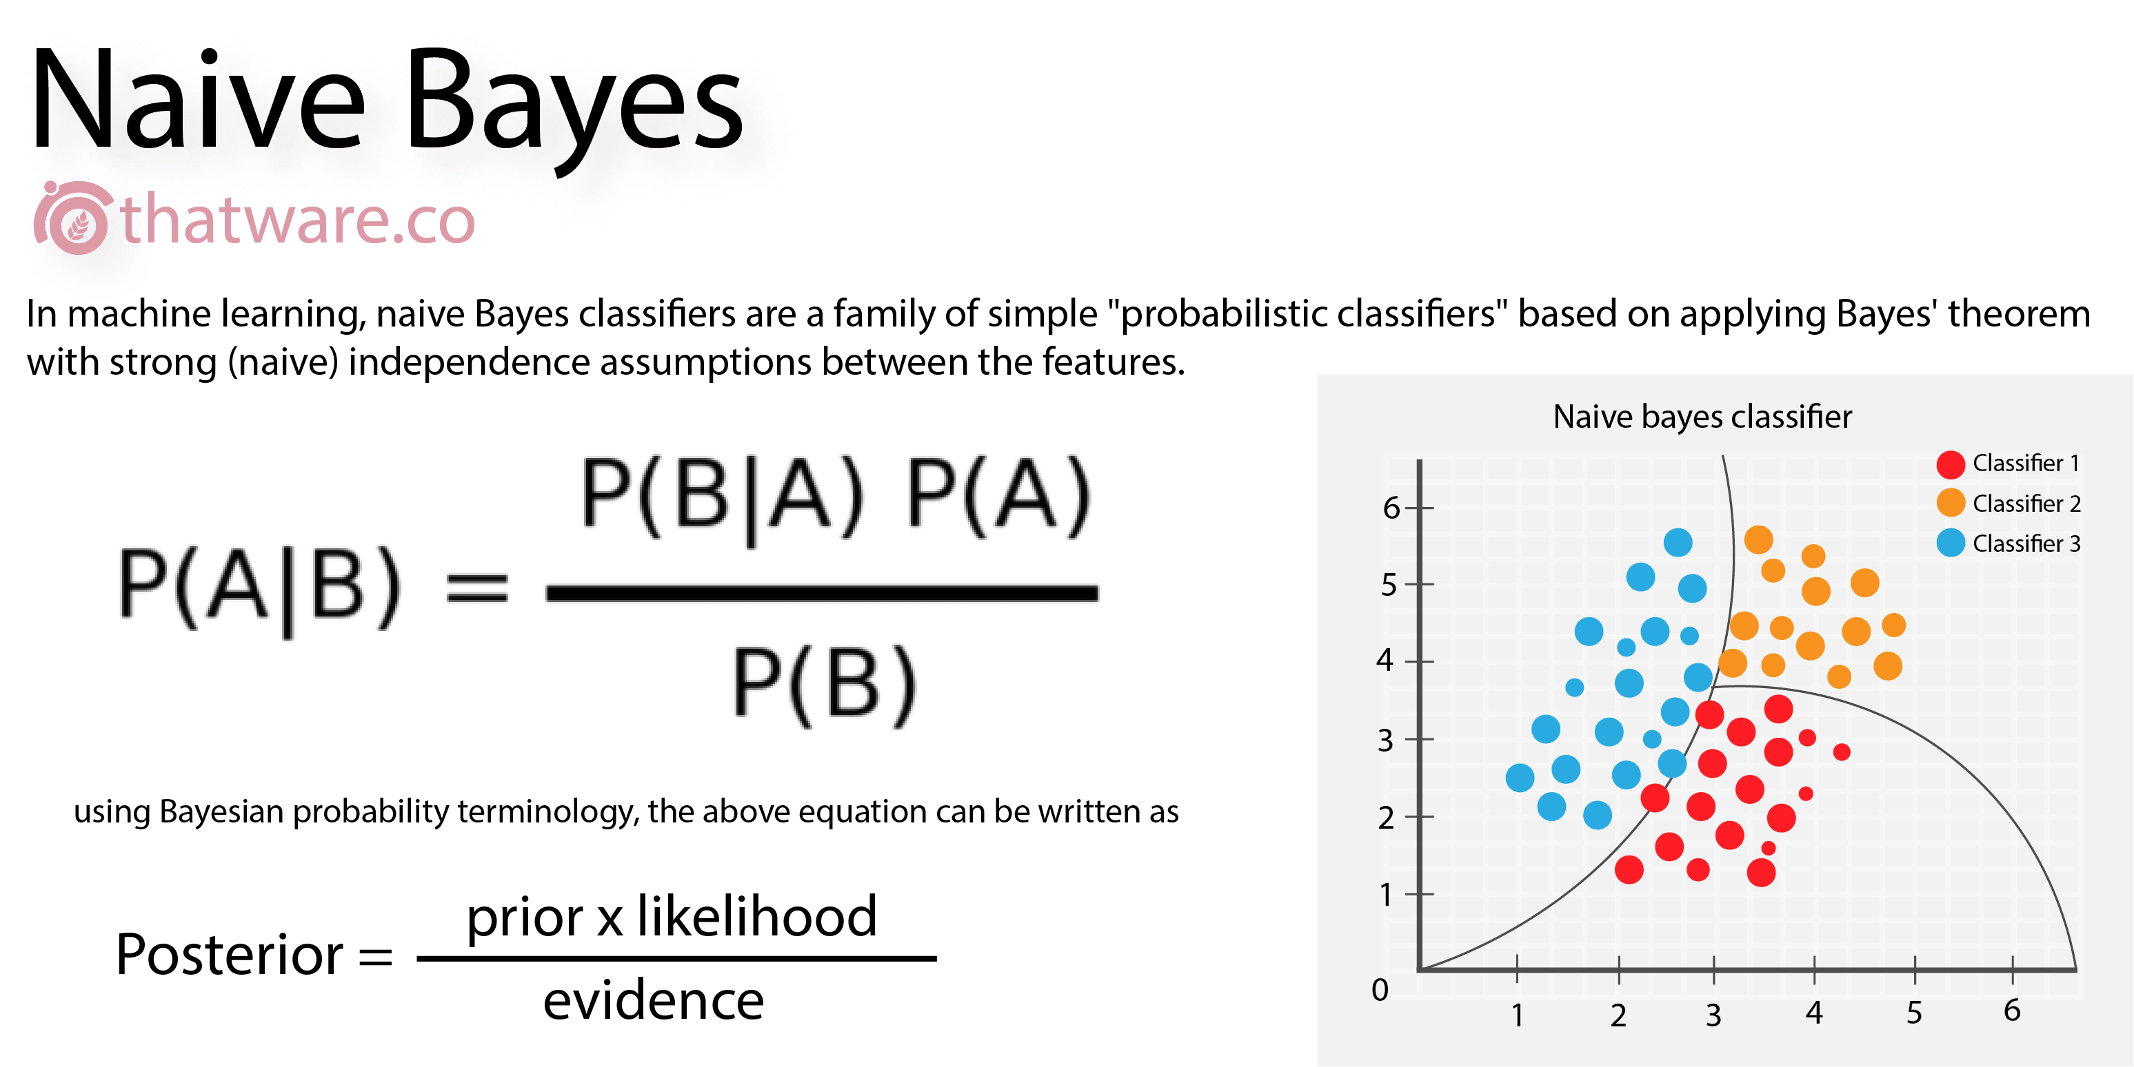

Slide 26

Advantages:
Low computation cost.
It can effectively work with large datasets.
For small sample sizes, Naive Bayes can outperform the most powerful alternatives.
Easy to implement, fast and accurate method of prediction.
Can work with multiclass prediction problems.
It performs well in text classification problems.
Applications:
Naive Bayes classifier is used in Text Classification, Spam filtering and Sentiment Analysis. It has a higher success rate than other algorithms.
Naïve Bayes along with Collaborative filtering are used in Recommended Systems.
It is also used in disease prediction based on health parameters.
This algorithm has also found its application in Face recognition.
Naive Bayes is used in prediction of weather reports based on atmospheric conditions (temp, wind, clouds, humidity etc.)

Slide 27
Trigram Vectorizer:
The process of converting words into numbers are called Vectorization.
We opt to use a Trigram vectorizer here, which vectorizes triplets of words rather than each word separately.
In this short example sentence, the trigrams are “In this short”, “this short example” and “short example sentence”.
Let us say from a document we want to find out the skills required to be a “Data Scientist”. Here, if we consider only unigrams, then the single word cannot convey the details properly. If we have a word like ‘Machine learning developer’, then the word extracted should be ‘Machine learning’ or ‘Machine learning developer’. The words simply ‘Machine’, ‘learning’ or ‘developer’ will not give the expected result.

Slide 28
Maximum Entropy Classifier
The Max Entropy classifier is a probabilistic classifier
It belongs to the class of exponential models.
Unlike the Naive Bayes classifier that we discussed in the previous slides, the Max Entropy does not assume that the features are conditionally independent of each other
Due to the minimum assumptions that the Maximum Entropy classifier makes, we regularly use it when we don’t know anything about the prior distributions and when it is unsafe to make any such assumptions.
The Max Entropy classifier is a discriminative classifier commonly used in Natural Language Processing, Speech and Information Retrieval problems.
It is based on the Principle of Maximum Entropy

Slide 29
The Max Entropy requires more time to train comparing to Naive Bayes.
This method provides robust results.
Our target is to use the contextual information of the document (trigram characteristics within the text) .
Categorizing it to a given class (positive/neutral/negative, objective/subjective etc).
Applications
Prior probabilities
Posterior probabilities
Maximum entropy models
Probability density estimation

Slide 30
Web Application Architecture:
we need a web interface in which the user can enter some news text.
Click on a button for the application to preprocess the input and feed it to the trained model and show the classification back on screen.
Frontend/UI:
This is going to be a simple one page with one input and a button
Backend/Server:
Since we need to “unpickle” or pickle.load() our model (the pipeline) to use it, the best choice would be a python web server that can receive the input over HTTP and return back the prediction result. One of the easiest and most straightforward frameworks for this is Flask.

Slide 31
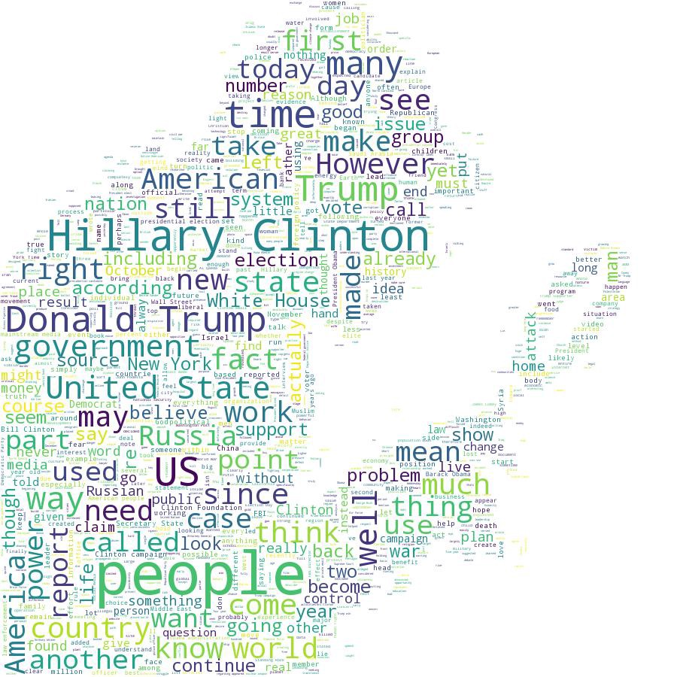
DATASETS
The datasets we used in this study are open source and freely available online.
The data includes both fake and truthful news articles from multiple domains.
The truthful news articles published contain true description of real world events, while the fake news websites contain claims that are not aligned with facts.
We have download one of our dataset from Kaggle and the other from the some random website.

Slide 32

DESIGN
Front End :-
The part of a website that user interacts with directly is termed as front end.
It is also referred to as the ‘client side’ of the application
The Front End of our project is designed using
HTML
CSS
JavaScript
Back End :-
It is the portion of software that does not come in direct contact with the users.
Backend is server side of the website.
The Back End of our project is designed using
Python
PHP

Slide 33

UML DIAGRAMS

Slide 34
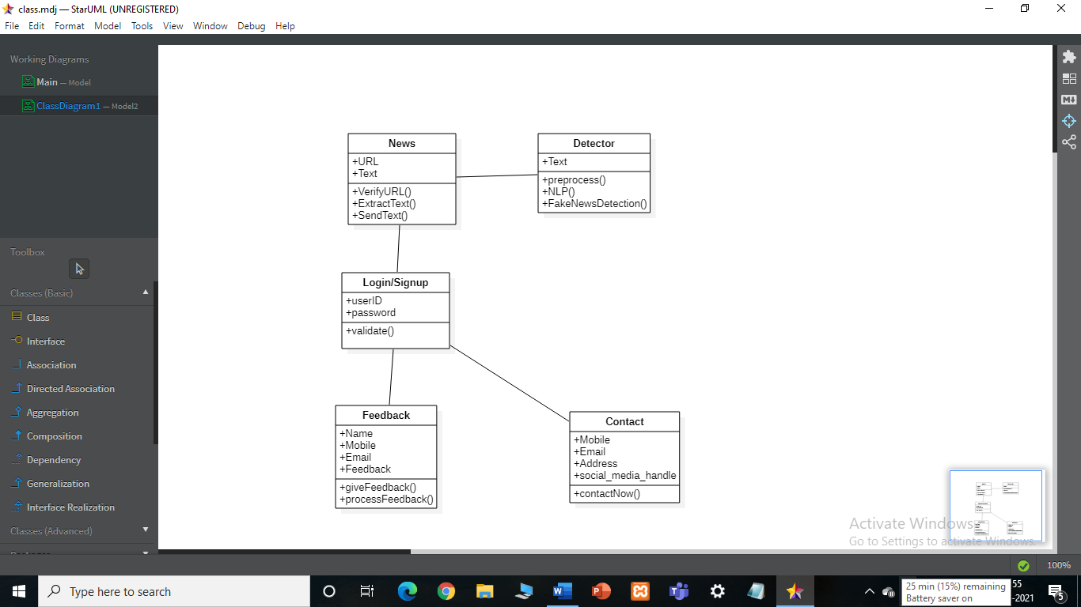
Class Diagram:

Slide 35
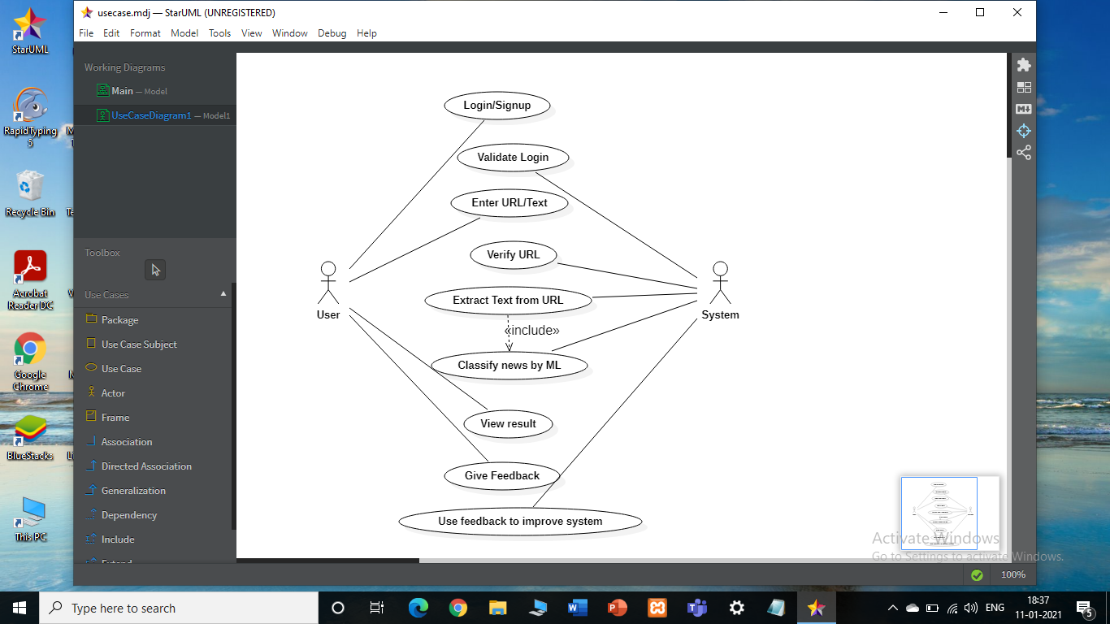
Usecase diagram:

Slide 36
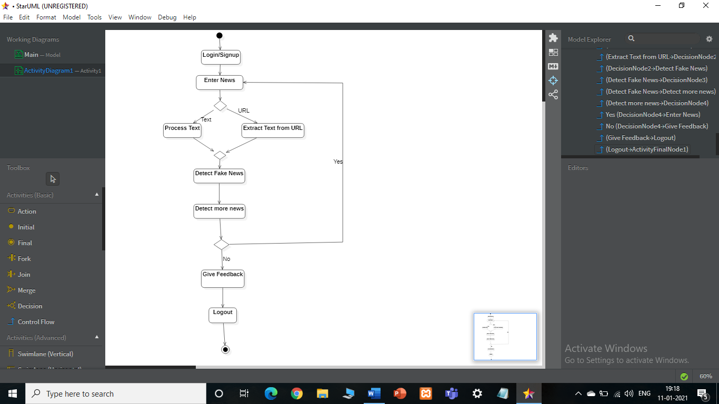
Activity Diagram:

Slide 37
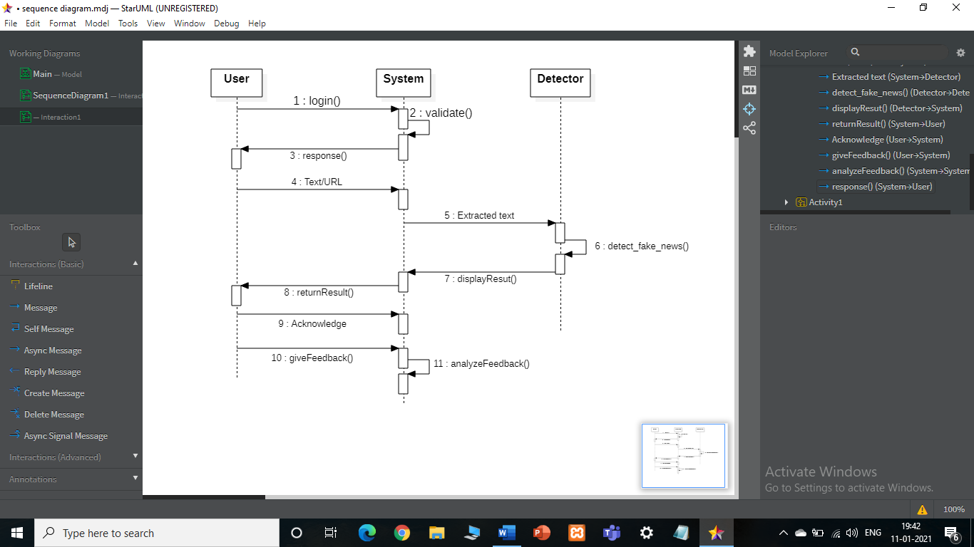
Sequence Diagram:

Slide 38
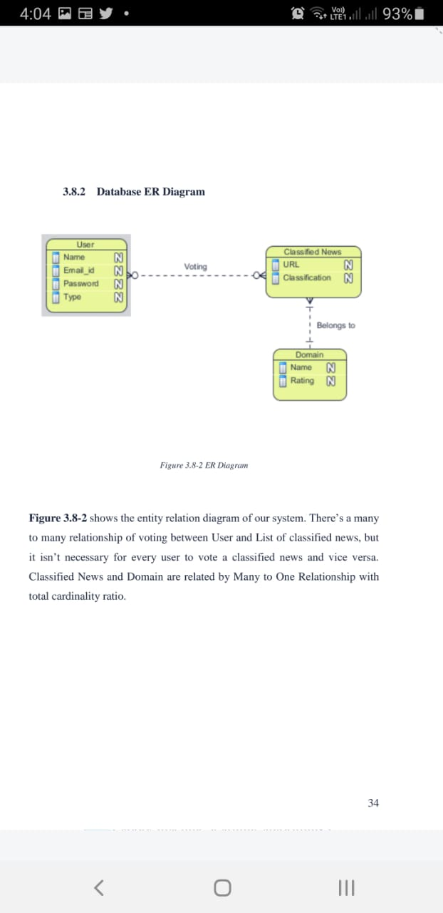

Slide 39
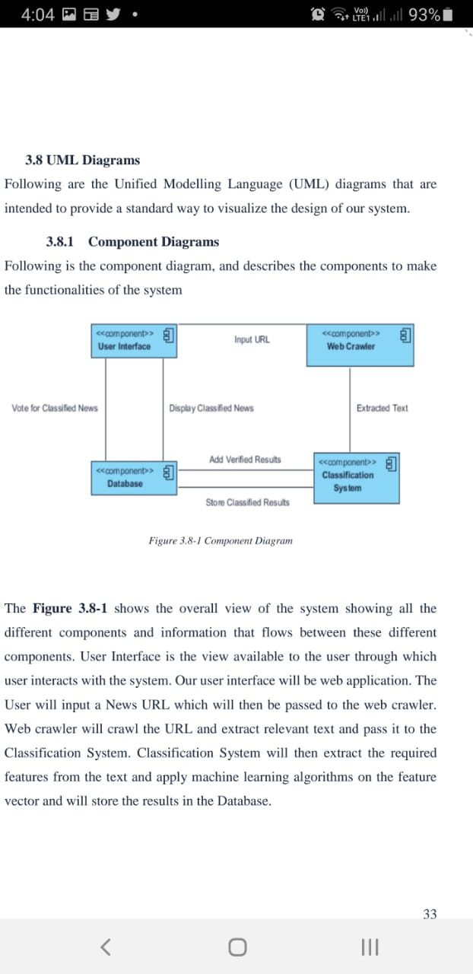

Slide 40
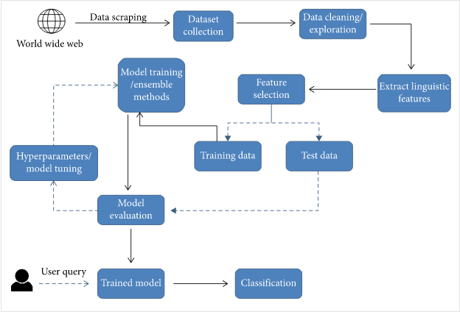
SYSTEM ARCHITECTURE

Slide 41
CONCLUSION
The task of classifying news manually requires in-depth knowledge of the domain and expertise to identify anomalies in the text. In this research, we discussed the problem of classifying fake news articles using machine learning models and ensemble techniques.
The data we used in our work is collected from the World Wide Web and contains news articles from various domains to cover most of the news rather than specifically classifying political news.
The primary aim of the research is to identify patterns in text that differentiate fake articles from true news.
machine learning techniques can be employed to identify the key sources involved in spread of fake news

Slide 42
REFERENCES
Chris Reed, D. Walton, and F. Macagno. Argument diagramming in logic, law and artificial intelligence. The Knowledge Engineering Review, 22(01):87 – 109, 2007. detection: Methods for finding fake news." Proceedings of the Association for Information Science and Technology 52.1 (2015): 1-4.
❑ Kolari, Pranam, et al. "Detecting spam blogs: A machine learning approach." AAAI . Vol. 6. 2006.
❑ Douglas Walton, Christopher Reed, and Fabrizio Macagno. Argumentation Schemes. Cambridge University Press, 2008.
❑ Davis, Wynne. "Fake Or Real? How To Self-Check The News And Get The potentially misleading news." Proceedings of the Second Workshop on Computational Approaches to Deception Detection . 2016
❑ Kolari, Pranam, et al. "Detecting spam blogs: A machine learning

